Slide 1
COLOR BALANCE AND FUSION FOR UNDER WATER IMAGE ENHANCEMENT
COLOR BALANCE AND FUSION FOR UNDER WATER IMAGE ENHANCEMENT
ABHAY BALAN
Class No:2 S7 B-Tech CSE
Dept. of CSE, MACE Kothamangalam
September,2018

Slide 2
CONTENTS
COLOR BALANCE AND FUSION FOR UNDER WATER IMAGE ENHANCEMENT
Introduction
Background Knowledge
Related Work
Proposed method- Advantages
Proposed method- Working
Conclusion
References
Dept. of CSE, MACE Kothamangalam

Slide 3
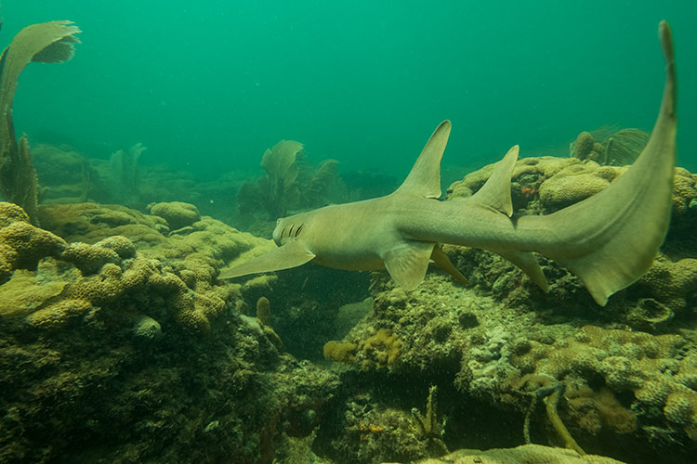
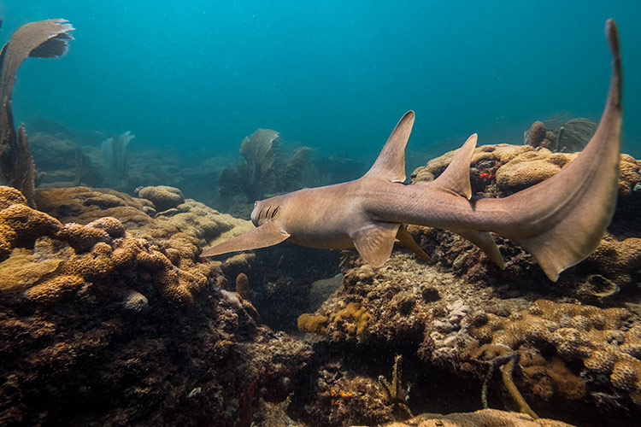
INTRODUCTION
COLOR BALANCE AND FUSION FOR UNDER WATER IMAGE ENHANCEMENT
Under water imaging?
Under water infrastructure
Cables
Detection of man made objects
Control under water vehicles
How it differs from common images?
(courtesy: http://ieeexplore.org)
Dept. of CSE, MACE Kothamangalam

Slide 4
Reason For Poor Visibility
COLOR BALANCE AND FUSION FOR UNDER WATER IMAGE ENHANCEMENT
Absorption
Substantially reduces the light energy.
Red (10-15 ft)
Orange (20-25 ft)
yellow (35-45 ft)
Scattering
Changes in the light propagation direction.
Dept. of CSE, MACE Kothamangalam

Slide 5
Light Propagation in Underwater
COLOR BALANCE AND FUSION FOR UNDER WATER IMAGE ENHANCEMENT
Variation of light available under water
Angle of incidence of sun light
Density of particles in sea water
Different wavelength of light
Dept. of CSE, MACE Kothamangalam

Slide 6
Simplified Under Water Camera Model
COLOR BALANCE AND FUSION FOR UNDER WATER IMAGE ENHANCEMENT
McGlamery and Jaffe components
Direct component
forward scattering component
Back-scattering component
I(x)= J(x)e−ηd(x)+B∞(x)(1−e−ηd(x))
Dept. of CSE, MACE Kothamangalam

Slide 7
Under Water Lidar imaging system
COLOR BALANCE AND FUSION FOR UNDER WATER IMAGE ENHANCEMENT
Optical/laser-sensing technique
Capture turbid underwater images.
Complex
Very expensive
Power consuming
Dept. of CSE, MACE Kothamangalam

Slide 8
Polarization-based method
COLOR BALANCE AND FUSION FOR UNDER WATER IMAGE ENHANCEMENT
Capture : different degrees of polarization
Rotating a polarizing ﬁlter ﬁxed to the camera
Not applicable to video acquisition
Limited when dealing with dynamic scenes
Dept. of CSE, MACE Kothamangalam

Slide 9
Underwater Dark Channel Prior
COLOR BALANCE AND FUSION FOR UNDER WATER IMAGE ENHANCEMENT
Used for removing the haze
Adaptation of the Dark Channel Prior
Not applicable in poor light
Dept. of CSE, MACE Kothamangalam

Slide 10
Proposed method- Advantages
COLOR BALANCE AND FUSION FOR UNDER WATER IMAGE ENHANCEMENT
Single image approach
Not require specialized hardware
Not require previous knowledge (UW conditions)
Algorithm independent of the camera settings
improves the accuracy
Dept. of CSE, MACE Kothamangalam

Slide 11
Proposed method- Working
COLOR BALANCE AND FUSION FOR UNDER WATER IMAGE ENHANCEMENT
Gamma
Correction
White Balancing
Multiscale
Fusion
INPUT
OUTPUT
Sharpening
Dept. of CSE, MACE Kothamangalam

Slide 12
White Balancing
COLOR BALANCE AND FUSION FOR UNDER WATER IMAGE ENHANCEMENT
Aim: Compensating absorbed colour
Removing the undesired colour castings
Green channel is well preserved under water
Stronger attenuation induced on red
Compensate the lose of red first
Dept. of CSE, MACE Kothamangalam

Slide 13
Gray World Assumption
COLOR BALANCE AND FUSION FOR UNDER WATER IMAGE ENHANCEMENT
Average value of all channels of a image is Gray
Good distribution of colours in the scene
Assume all channels have same mean value before attenuation
Deference reflects, attenuation of red
Composition of red only highly attenuated regions
Dept. of CSE, MACE Kothamangalam

Slide 14
Compensated Red Chanel
COLOR BALANCE AND FUSION FOR UNDER WATER IMAGE ENHANCEMENT
Compensated red by adding fraction of green channel
Equation:
Irc(x)= Ir(x)+α.(Igm − Irm).(1− Ir(x)).Ig(x)
Irc : Compensated red channel
Ir : Red colour channel of image of I
Ig : Green colour channel of image of I
Igm : Mean value of Ig
Irm : Mean value of Ir
α : A constant parameter (here 1)
Dept. of CSE, MACE Kothamangalam

Slide 15
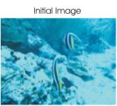
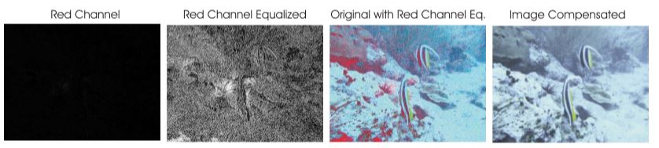
Example
COLOR BALANCE AND FUSION FOR UNDER WATER IMAGE ENHANCEMENT
(courtesy: http://ieeexplore.org)
Dept. of CSE, MACE Kothamangalam

Slide 16
Compensated Blue Chanel
COLOR BALANCE AND FUSION FOR UNDER WATER IMAGE ENHANCEMENT
Due to absorption by Organic mater , turbidity
Equation:
Ibc(x)= Ib(x)+α.(Igm − Ib).(1− Ib(x)).Ig(x)
Ibc : Compensated red channel
Ir : Red colour channel of image of I
Ib : Blue colour channel of image of I
Ibm : Mean value of Ib
Igm : Mean value of Ig
α : A constant parameter (here 1)
Dept. of CSE, MACE Kothamangalam

Slide 17
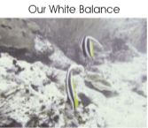
Advantages: White Balancing
COLOR BALANCE AND FUSION FOR UNDER WATER IMAGE ENHANCEMENT
Reddish appearance regions well corrected
Recover color solved
Result
(courtesy: http://ieeexplore.org)
Dept. of CSE, MACE Kothamangalam

Slide 18
MULTI-SCALE FUSION
COLOR BALANCE AND FUSION FOR UNDER WATER IMAGE ENHANCEMENT
Aim: Enhance the edges & Details of the screen
Deeper than 30 ft ,
Absorbed colors difficult to recovered
4 Steps
Inputs of the fusion process
Weight of the fusion process
Native fusion process
Multiscale fusion process
Dept. of CSE, MACE Kothamangalam

Slide 19
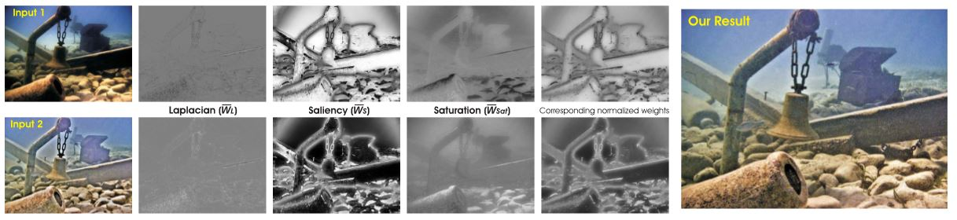
Input of the fusion process
COLOR BALANCE AND FUSION FOR UNDER WATER IMAGE ENHANCEMENT
Gamma Correction:
Correcting global contrast
Increase the difference b/w darker & brighter regions
Edge Sharpening:
Un-sharp masking Principle
For enhancing the edges,
(Original image – smooth or blued version of image)
(courtesy: http://ieeexplore.org)
Dept. of CSE, MACE Kothamangalam

Slide 20
Sharpening
COLOR BALANCE AND FUSION FOR UNDER WATER IMAGE ENHANCEMENT
S = I +β(I −G ∗ I)
G*I = Gaussian filtered image
β is not trivial
If small : Sharpening fails
If large : Over saturated
S = (I +N{I - G*I})/2
N{.} =Normalization operator
Shift and scaling all color pixel intensities
(courtesy: http://ieeexplore.org)
Dept. of CSE, MACE Kothamangalam

Slide 21
Weights of the Fusions Process
COLOR BALANCE AND FUSION FOR UNDER WATER IMAGE ENHANCEMENT
Pixel with high weight values more represented in final image
3 types of weight maps
Laplacian weight map:
Estimate global contrast
Can not distinguish ramp & flat regions
Dept. of CSE, MACE Kothamangalam
(courtesy: http://ieeexplore.org)

Slide 22
Weights of the Fusions Process
COLOR BALANCE AND FUSION FOR UNDER WATER IMAGE ENHANCEMENT
Saliency weight map:
Aim: All pixel value have unique quality
Image Segmentation – Easy to analyze
Highlighted areas - Saturation decreases
Saturation weight map:
Enables fusion process
Calculate deviation between color channels and luminance
Normalized weight Map : Wk=Wl+Ws+Wsat
Dept. of CSE, MACE Kothamangalam

Slide 23
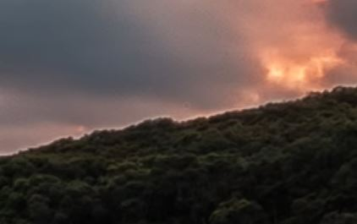
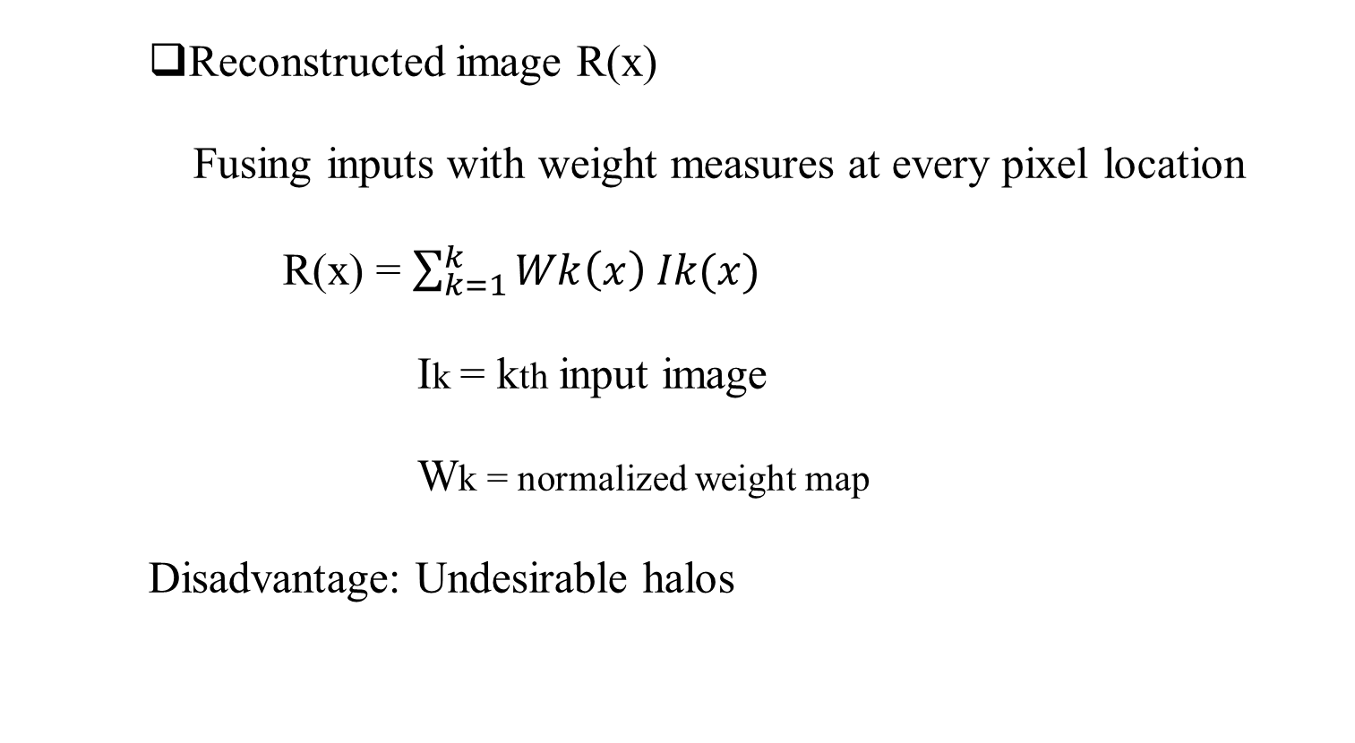
Native Fusion Process
COLOR BALANCE AND FUSION FOR UNDER WATER IMAGE ENHANCEMENT
Reconstructed image R(x)
Fusing inputs with weight measures at every pixel location
R(x) = $\sum_{k=1}^{k}{Wk\left(x\right) Ik(x)}$
Ik = kth input image
Wk = normalized weight map
Disadvantage: Undesirable halos
(courtesy: http://youtube.com)
Dept. of CSE, MACE Kothamangalam

Slide 24
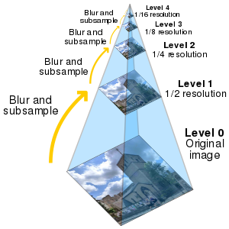
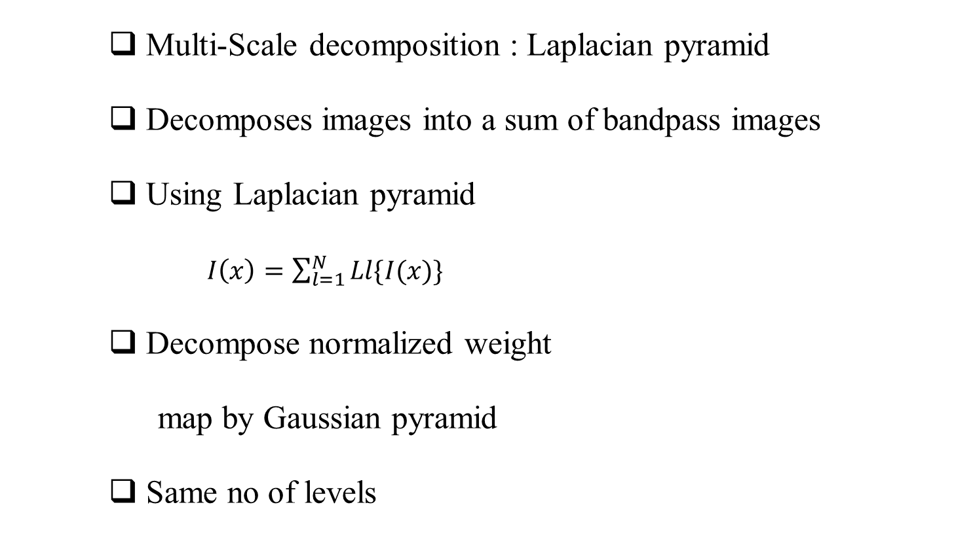
Multi-Scale Fusion Process
COLOR BALANCE AND FUSION FOR UNDER WATER IMAGE ENHANCEMENT
Multi-Scale decomposition : Laplacian pyramid
Decomposes images into a sum of bandpass images
Using Laplacian pyramid
$I\left(x\right)=\sum_{l=1}^{N}{Ll\{I(x)\} }$
Decompose normalized weight
map by Gaussian pyramid
Same no of levels
(courtesy:en.wikipedia.org)
Dept. of CSE, MACE Kothamangalam

Slide 25
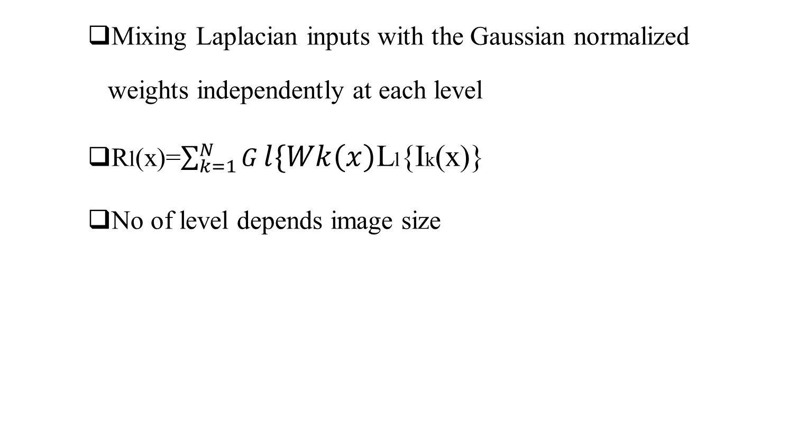
Multi-Scale Fusion Process
COLOR BALANCE AND FUSION FOR UNDER WATER IMAGE ENHANCEMENT
Mixing Laplacian inputs with the Gaussian normalized weights independently at each level
Rl(x)=$\sum_{k=1}^{N}{G}l\{Wk\left(x\right)$Ll{Ik(x)}
No of level depends image size
(courtesy: http://ieeexplore.org)
Dept. of CSE, MACE Kothamangalam

Slide 26
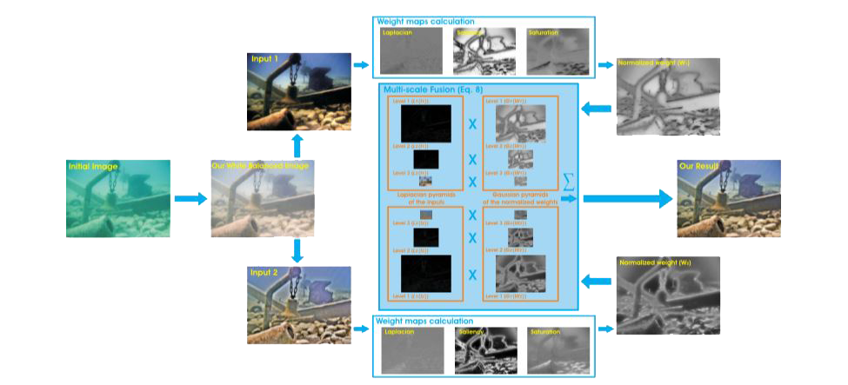
Proposed System
COLOR BALANCE AND FUSION FOR UNDER WATER IMAGE ENHANCEMENT
Gamma Corrected Version
Input
White Balanced Version
Output
Sharpened Version
(courtesy: http://ieeexplore.org)
Weight map calculation
Dept. of CSE, MACE Kothamangalam

Slide 27
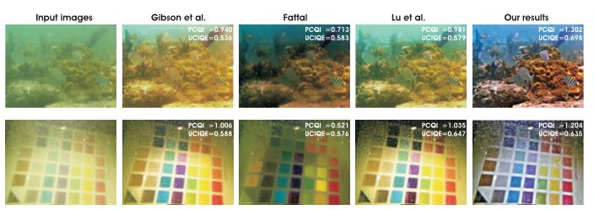
RESULTS AND DISCUSSION
COLOR BALANCE AND FUSION FOR UNDER WATER IMAGE ENHANCEMENT
Comparative results with the recent techniques
(courtesy: http://ieeexplore.org)
Dept. of CSE, MACE Kothamangalam

Slide 28
CONCLUSIONS
COLOR BALANCE AND FUSION FOR UNDER WATER IMAGE ENHANCEMENT
Strategy builds on the fusion principle and does not require additional information
Able to enhance a wide range of underwater images high accuracy
Proposed image enhancement technique for several challenging underwater computer vision applications.
Dept. of CSE, MACE Kothamangalam

Slide 29
Refferance
COLOR BALANCE AND FUSION FOR UNDER WATER IMAGE ENHANCEMENT
[1] M. D. Kocak, F. R. Dalgleish, M. F. Caimi, and Y. Y. Schechner, “A focus on recent developments and trends in underwater imaging,” Marine Technol. Soc. J., vol. 42, no. 1, pp. 52–67, 2008.
[2] G. L. Foresti, “Visual inspection of sea bottom structures by an autonomous underwater vehicle,” IEEE Trans. Syst., Man, Cybern. B, Cybern., vol. 31, no. 5, pp. 691–705, Oct. 2001.
[3] A. Ortiz, M. Simó, and G. Oliver, “A vision system for an underwater cable tracker,” Mach. Vis. Appl., vol. 13, pp. 129–140, Jul. 2002.
[4] A. Olmos and E. Trucco, “Detecting man-made objects in unconstrained subsea videos,” in Proc. BMVC, Sep. 2002, pp. 1–10.
[5] B. A. Levedahl and L. Silverberg, “Control of underwater vehicles in full unsteady ﬂow,” IEEE J. Ocean. Eng., vol. 34, no. 4, pp. 656–668, Oct. 2009
Dept. of CSE, MACE Kothamangalam

Slide 30
Refferance
COLOR BALANCE AND FUSION FOR UNDER WATER IMAGE ENHANCEMENT
[6] C. H. Mazel, “In situ measurement of reﬂectance and ﬂuorescence spectra to support hyperspectral remote sensing and marine biology research,” in Proc. IEEE OCEANS, Sep. 2006, pp. 1–4.
[7] Y. Kahanov and J. G. Royal, “Analysis of hull remains of the Dor D Vessel, Tantura Lagoon, Israel,” Int. J. Nautical Archeol., vol. 30, pp. 257–265, Oct. 2001.
[8] R. Schettini and S. Corchs, “Underwater image processing: state of the art of restoration and image enhancement methods,” EURASIP J. Adv. Signal Process., vol. 2010, Dec. 2010, Art. no. 746052.
[9] S. G. Narasimhan and S. K. Nayar, “Contrast restoration of weather degraded images,” IEEE Trans. Pattern Anal. Mach. Learn., vol. 25, no. 6, pp. 713–724, Jun. 2003.
Dept. of CSE, MACE Kothamangalam

Slide 31
COLOR BALANCE AND FUSION FOR UNDER WATER IMAGE ENHANCEMENT
Thanks
Dept. of CSE, MACE Kothamangalam

